Slide 1
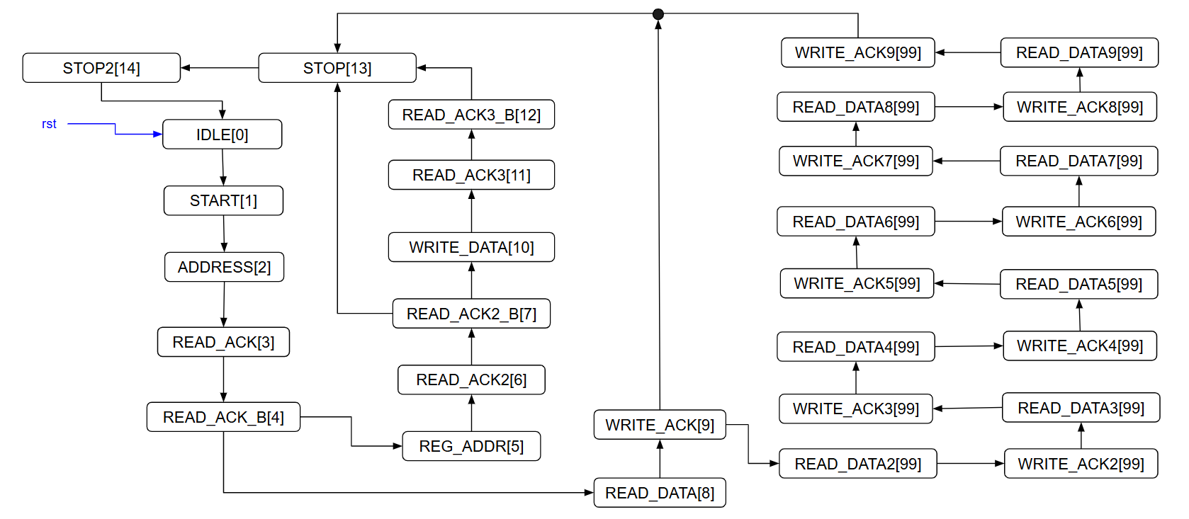


Write register

Slide 2




Write one byte register

Slide 3

Write nine bytes register

Slide 4
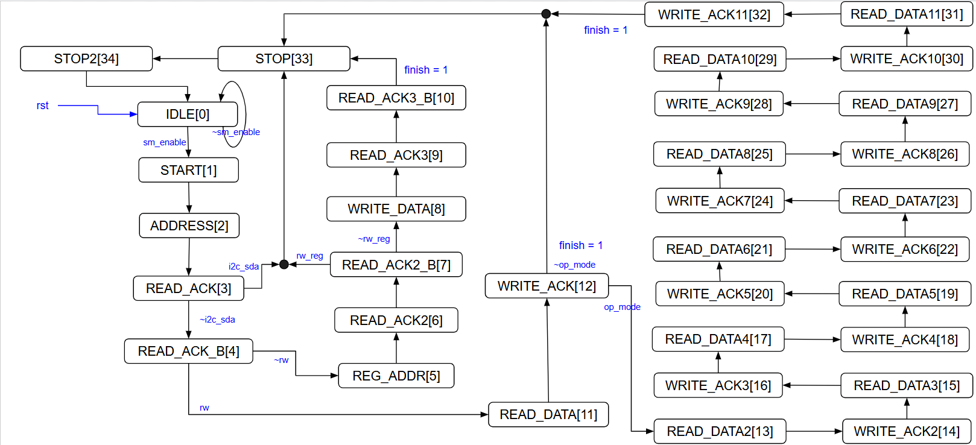

Write register

Slide 5



Read 1 byte register

Slide 6

Read 1 byte register

Slide 8
Control register: EN, r/w, mode(cpu, fpga)
Status register: finish, ready
模式分為cpu(藉由C code做r/w)與FPGA，cpu mode可寫可讀(1byte, 11 bytes)，
Fpga mode只可讀11bytes。

Slide 9
ctrl register:
bit 0: enable: start the state machine
bit 1: i_rw_reg: assign the command is write or read
bit 2~3 : op_mode: CPU or FPGA reading mode
00:CPU w/ 1byte, 01:CPU w/ 11bytes
10: FPGA w/ 11bytes, 11: reserved
status register:
bit0 : ready
bit1: finish
bit9~2: sm

Slide 10
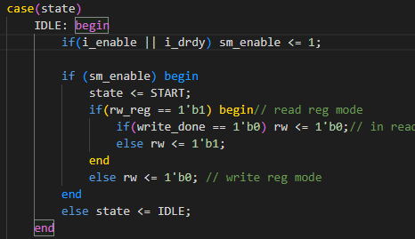
狀態機由sm_enable啟動，一直到STOP2時若write_done = 0時才會寫0
若為讀時(1 byte or 11 bytes)寫完reg後第二圈進入READ_DATE時write_done = 0
若為寫時write_done = 0
i_drdy or i_enable 任一訊號H時都會啟動狀態機

